Slide 1
Pt20Au80_AgBP1_fix_bulk_fraction_nAM_AP >= nPM_AP
2023-07-13

Slide 2
Input Parameters for DecomNano
Input Parameters (All) 67 data
Input Parameters (Droped parameters with no answer) 67 data
Parameter | Min | Max | Mean | Standard Deviation
dP | 2.8 | 2.8 | 2.8 | 0.0
dA | 2.9 | 2.9 | 2.9 | 0.0
fA | 0.8 | 0.8 | 0.8 | 0.0
nAA | 6.2 | 6.6 | 6.6 | 0.1
nPP | 9.2 | 9.2 | 9.2 | 0.0
nAP | 0.1 | 1.1 | 0.6 | 0.3
nPA | 0.3 | 0.3 | 0.3 | 0.0
DA | 6 | 6 | 6.0 | 0.0
DAP | 18 | 18 | 18.0 | 0.0
DP | 0 | 18 | 9.8 | 6.0
Parameter | Min | Max | Mean | Standard Deviation
dP | 2.8 | 2.8 | 2.8 | 0.0
dA | 2.9 | 2.9 | 2.9 | 0.0
fA | 0.8 | 0.8 | 0.8 | 0.0
nAA | 6.2 | 6.6 | 6.6 | 0.1
nPP | 9.2 | 9.2 | 9.2 | 0.0
nAP | 0.1 | 1.1 | 0.6 | 0.3
nPA | 0.3 | 0.3 | 0.3 | 0.0
DA | 6 | 6 | 6.0 | 0.0
DAP | 18 | 18 | 18.0 | 0.0
DP | 0 | 18 | 9.8 | 6.0

Slide 3
Ouput Parameters
Parameter | Min | Max | Mean | Standard Deviation
dP | 2.8 | 2.8 | 2.8 | 0.0
dA | 2.9 | 2.9 | 2.9 | 0.0
fA | 0.8 | 0.8 | 0.8 | 0.0
nAA | 6.2 | 6.6 | 6.6 | 0.1
nPP | 9.2 | 9.2 | 9.2 | 0.0
nAP | 0.1 | 1.1 | 0.6 | 0.3
nPA | 0.3 | 0.3 | 0.3 | 0.0
DA | 6 | 6 | 6.0 | 0.0
DAP | 18 | 18 | 18.0 | 0.0
DP | 0 | 18 | 9.8 | 6.0
nAM_AP | 9.6 | 11.7 | 10.1 | 0.3
nPM_AP | 9.4 | 9.6 | 9.5 | 0.0
nAA_AP | 4.7 | 6.9 | 6.6 | 0.4
nAP_AP | 3.2 | 6.4 | 3.5 | 0.6
nPA_AP | 0.3 | 0.5 | 0.3 | 0.0
nPP_AP | 8.9 | 9.2 | 9.2 | 0.1
XAP | 0.03 | 0.34 | 0.18 | 0.1
XA | 0.65 | 0.97 | 0.81 | 0.1
XP | 0.0 | 0.11 | 0.02 | 0.03
y | 0.08 | 0.09 | 0.09 | 0.0
dAP | 2.9 | 2.9 | 2.9 | 0.0
nMM_AP | 9.6 | 9.6 | 9.6 | 0.0
nAA_A | 6.6 | 6.6 | 6.6 | 0.0
nPP_P | 0.0 | 9.6 | 7.1 | 2.9
NA | 14.0 | 14.0 | 14.0 | 0.0
NP | 1.0 | 180.0 | 66.6 | 62.4
NAP | 166.2 | 166.2 | 166.2 | 0.0
XA*NA | 9.1 | 13.6 | 11.3 | 1.5
XP*NP | 0.0 | 19.3 | 2.1 | 4.2
XAP*NAP | 4.7 | 56.2 | 29.4 | 16.3

Slide 4
Solution of DecomNano
Parameter | Min | Max | Mean | Standard Deviation
nAM_AP | 9.6 | 11.7 | 10.1 | 0.3
nPM_AP | 9.4 | 9.6 | 9.5 | 0.0
nAA_AP | 4.7 | 6.9 | 6.6 | 0.4
nAP_AP | 3.2 | 6.4 | 3.5 | 0.6
nPA_AP | 0.3 | 0.5 | 0.3 | 0.0
nPP_AP | 8.9 | 9.2 | 9.2 | 0.1
XAP | 0.03 | 0.34 | 0.18 | 0.1
XA | 0.65 | 0.97 | 0.81 | 0.1
XP | 0.0 | 0.11 | 0.02 | 0.03
y | 0.08 | 0.09 | 0.09 | 0.0

Slide 5
Other Parameters Calculated in the DecomNano
Parameter | Min | Max | Mean | Standard Deviation
dAP | 2.9 | 2.9 | 2.9 | 0.0
nMM_AP | 9.6 | 9.6 | 9.6 | 0.0
nAA_A | 6.6 | 6.6 | 6.6 | 0.0
nPP_P | 0.0 | 9.6 | 7.1 | 2.9
NA | 14.0 | 14.0 | 14.0 | 0.0
NP | 1.0 | 180.0 | 66.6 | 62.4
NAP | 166.2 | 166.2 | 166.2 | 0.0

Slide 6
Extracted Parameter Related to Hetereogeneity
Parameter | Min | Max | Mean | Standard Deviation
XA*NA | 9.1 | 13.6 | 11.3 | 1.5
XP*NP | 0.0 | 19.3 | 2.1 | 4.2
XAP*NAP | 4.7 | 56.2 | 29.4 | 16.3
y | 0.08 | 0.09 | 0.09 | 0.0
nAM_AP | 9.6 | 11.7 | 10.1 | 0.3
nPM_AP | 9.4 | 9.6 | 9.5 | 0.0

Slide 7
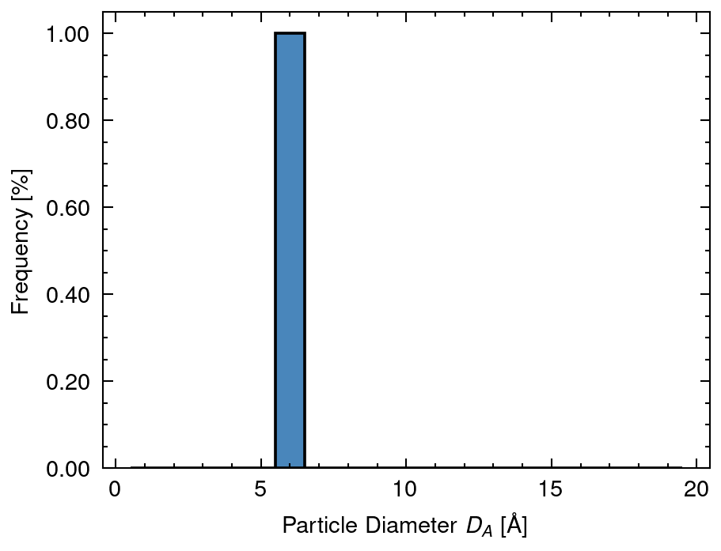
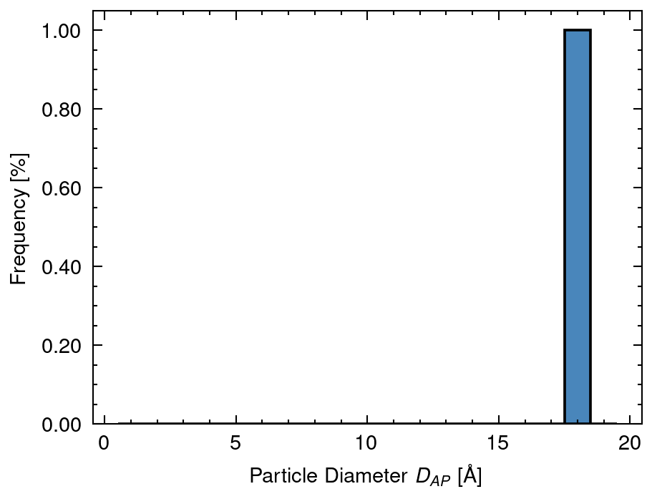
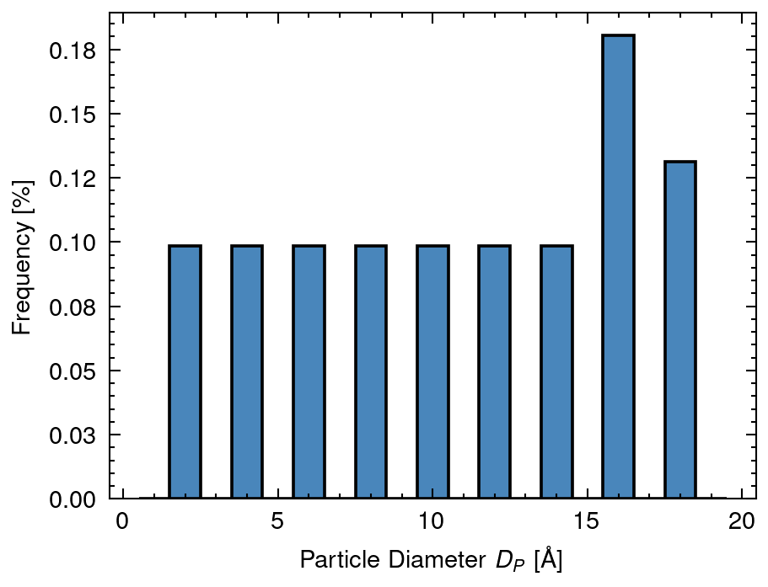
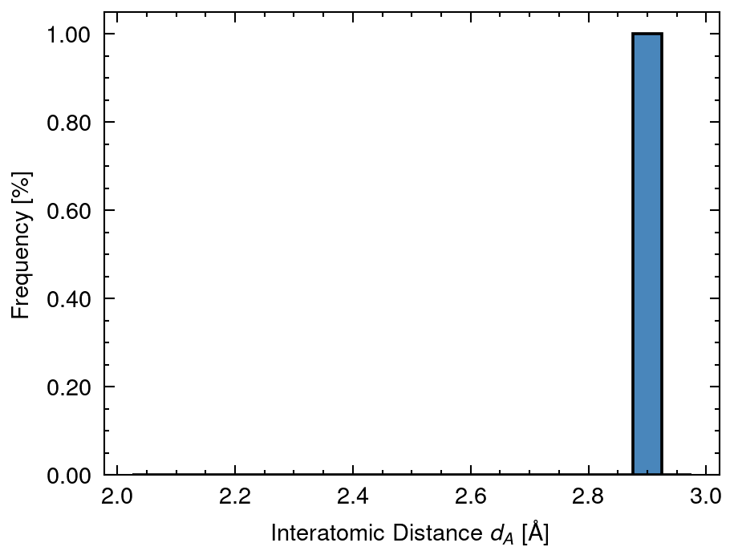
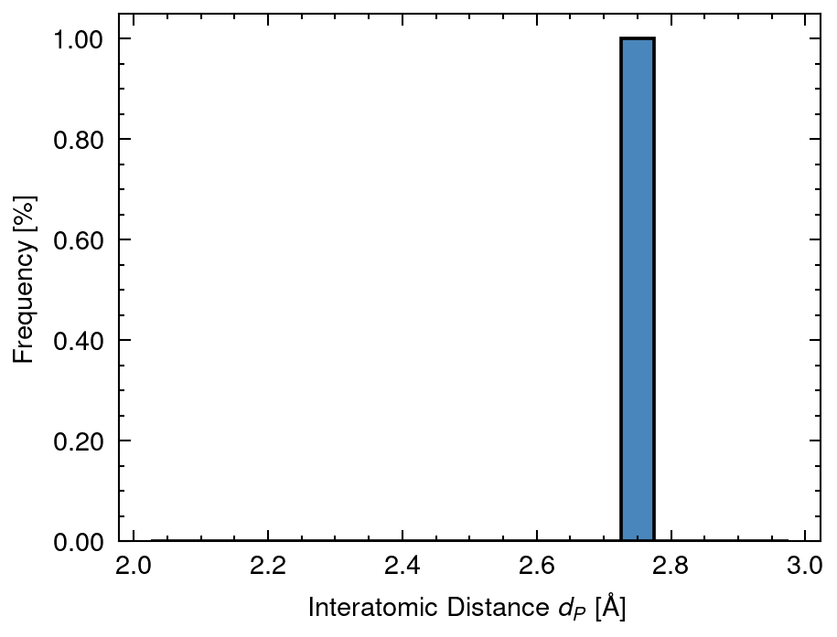
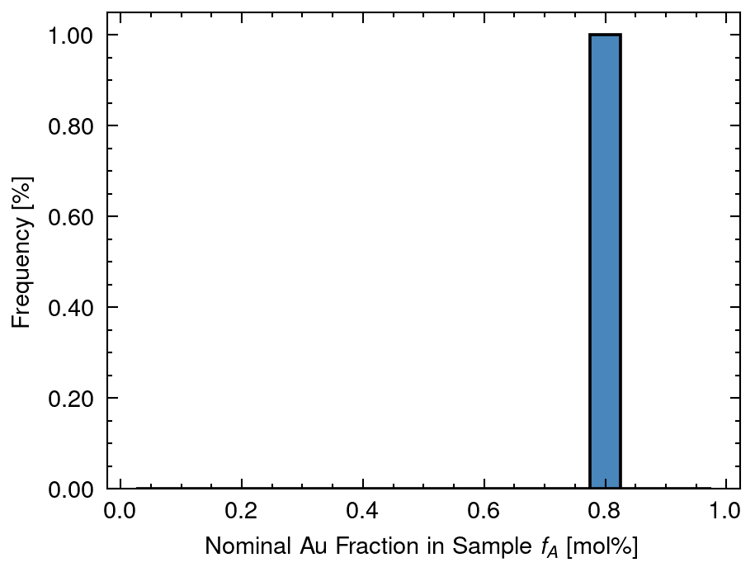
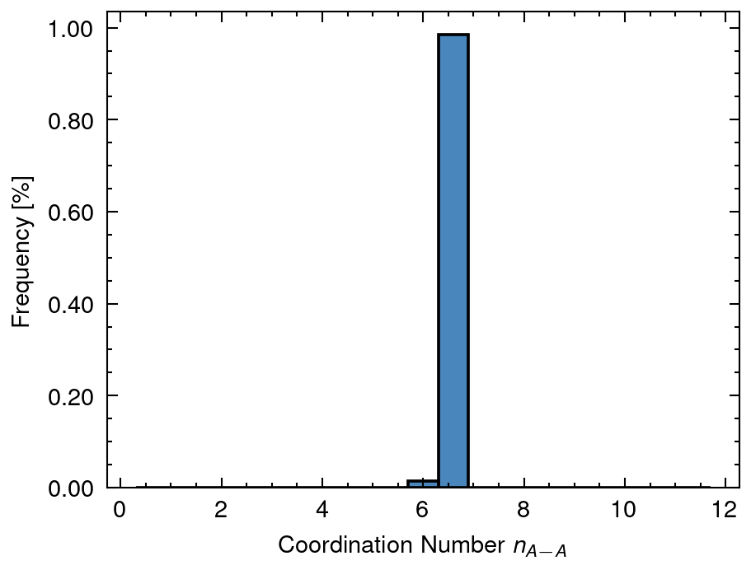
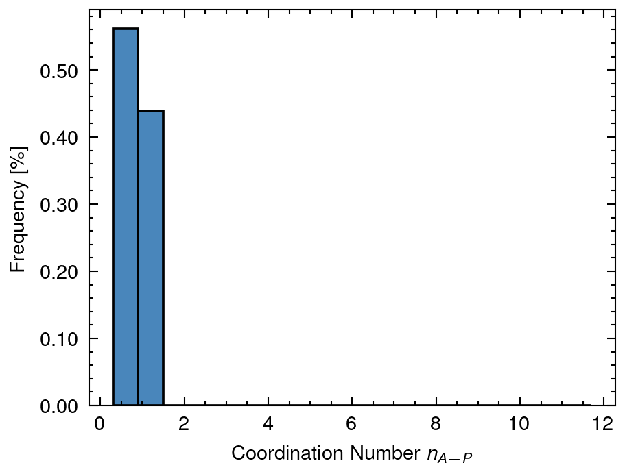
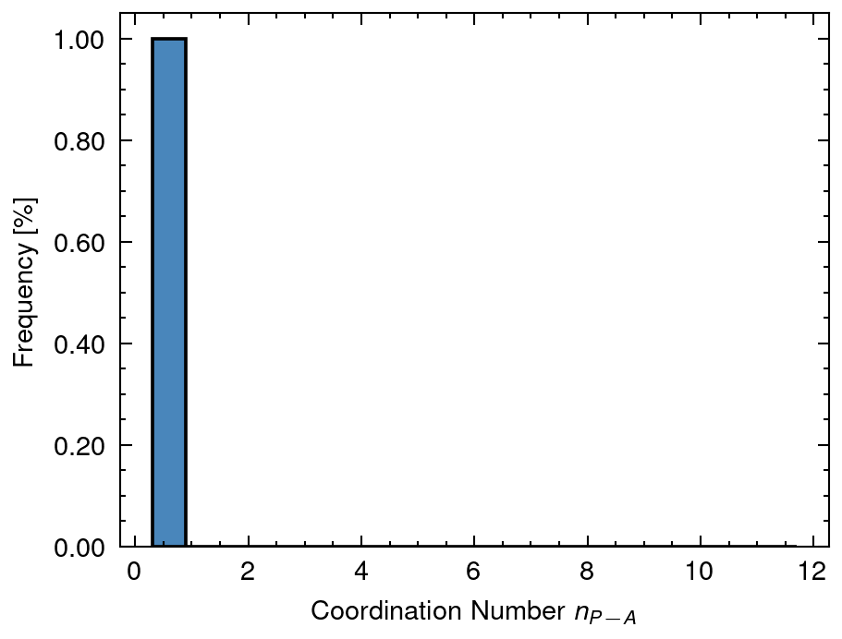
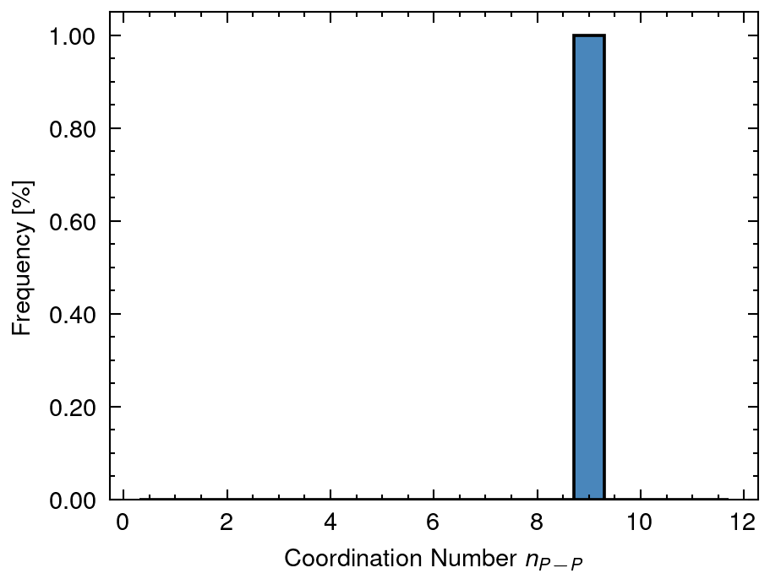
1 Distribution of input data
DA mean: 6.0 sd:0.0
DAP mean: 18.0 sd:0.0
DP mean: 9.79 sd:5.96
dA mean: 2.88 sd:0.0
dP mean: 2.77 sd:0.0
fA mean: 0.8 sd:0.0
nAA mean: 6.58 sd:0.07
nAP mean: 0.63 sd:0.35
nPA mean: 0.3 sd:0.0
nPP mean: 9.2 sd:0.0

Slide 8
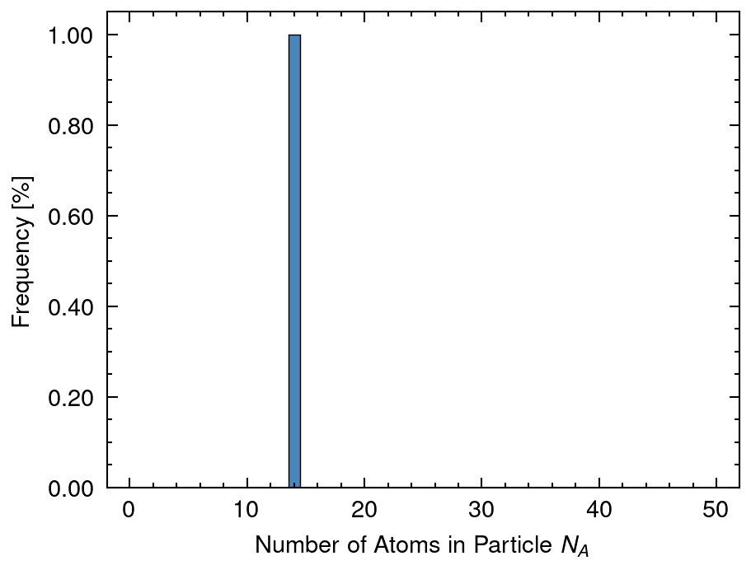
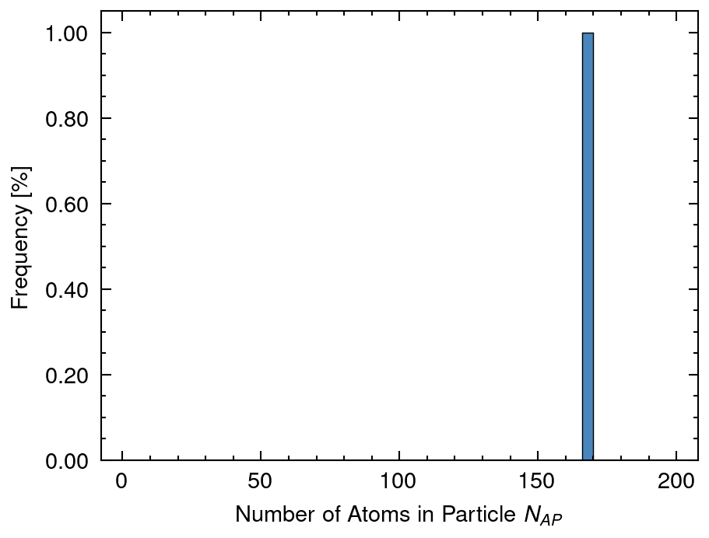
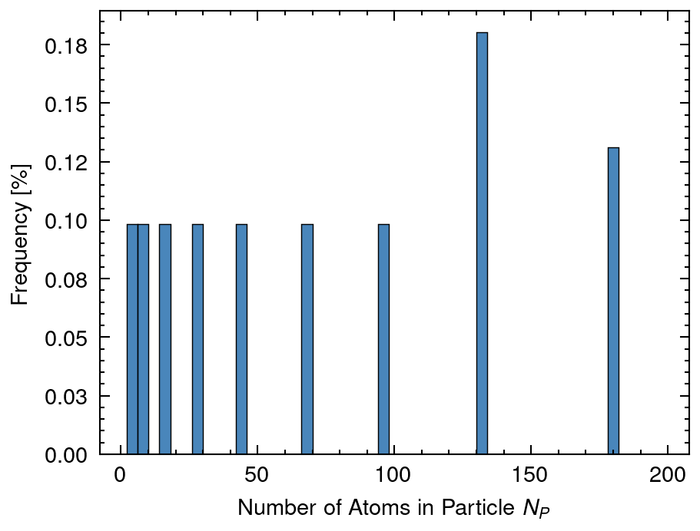
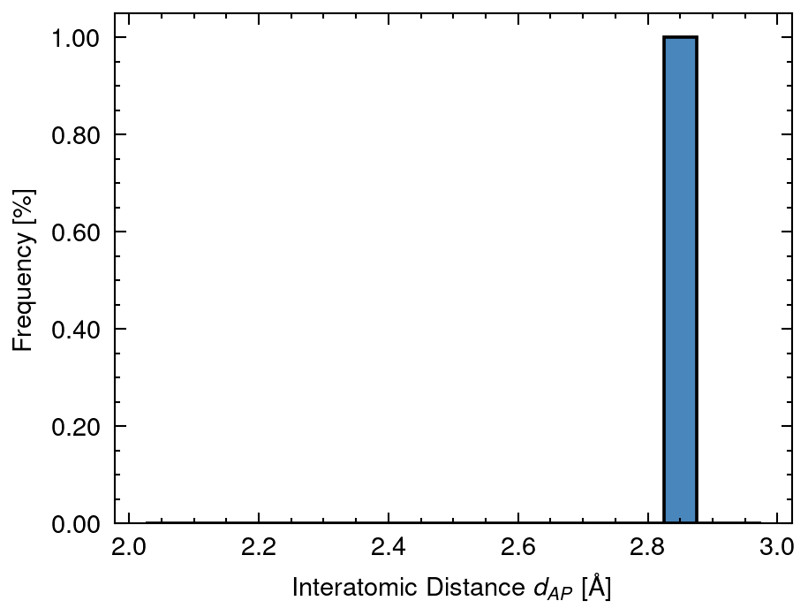
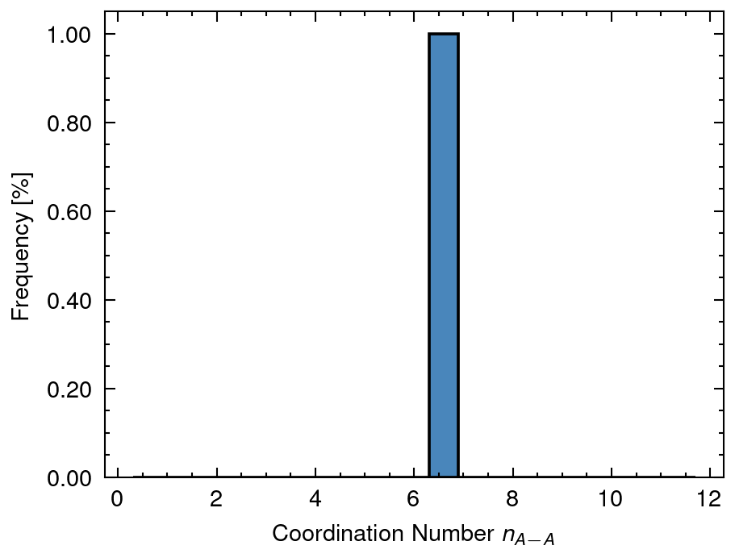
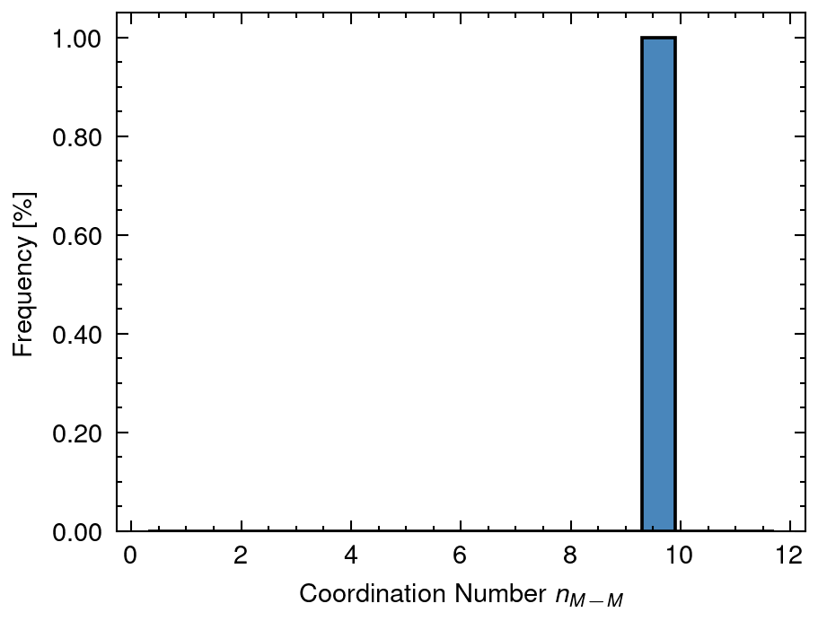
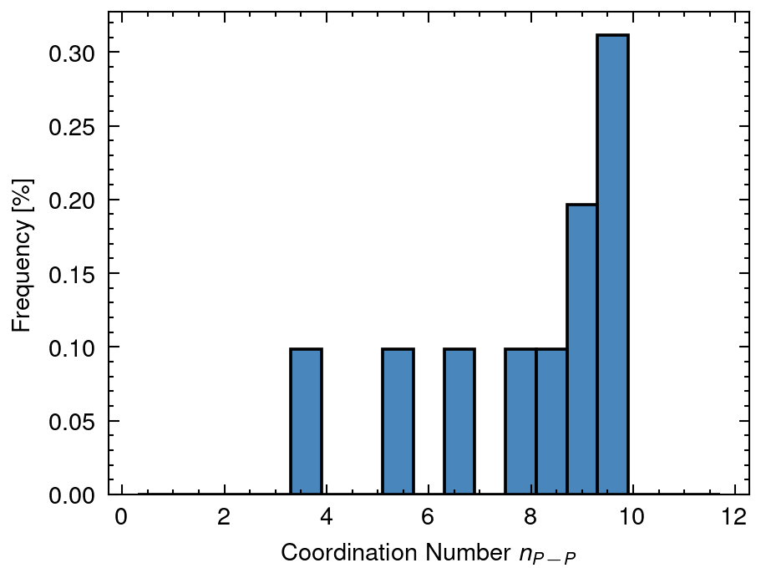
2 Distribution of calculated data
NA mean: 14.01 sd:0.0
NAP mean: 166.22 sd:0.0
NP mean: 66.65 sd:62.41
dAP mean: 2.86 sd:0.0
nAA_A mean: 6.59 sd:0.0
nMM_AP mean: 9.57 sd:0.0
nPP_P mean: 7.1 sd:2.9

Slide 9
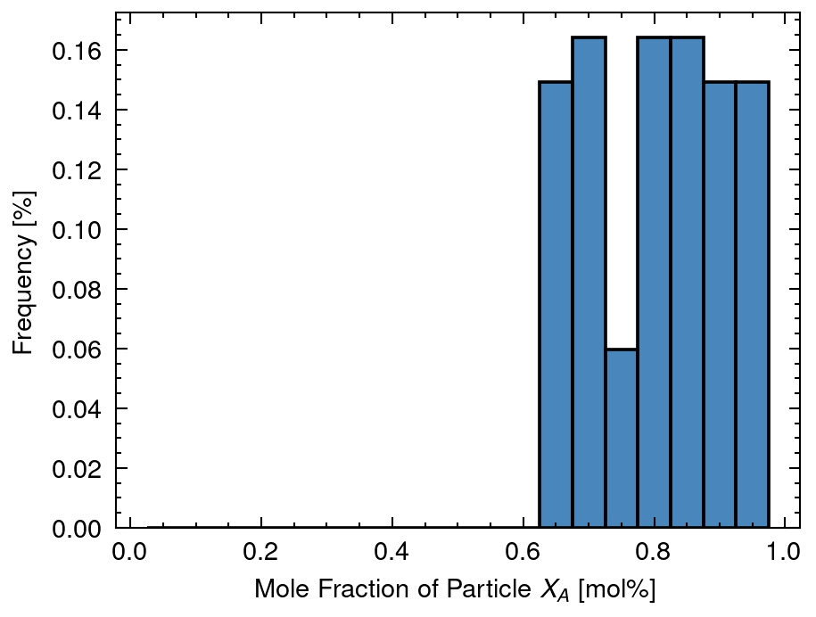
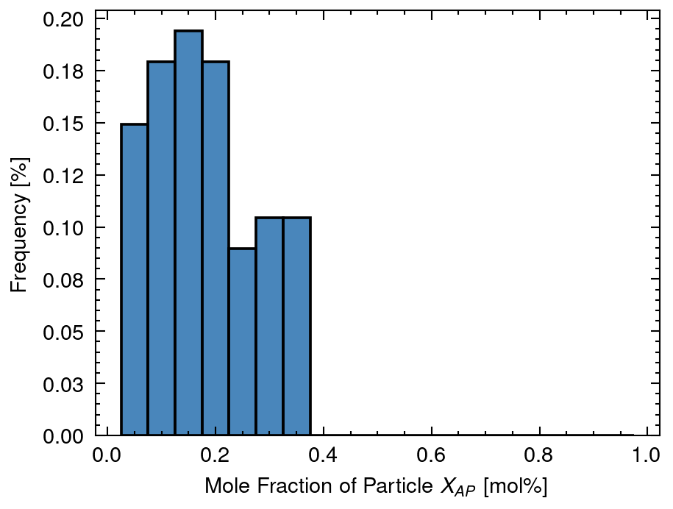
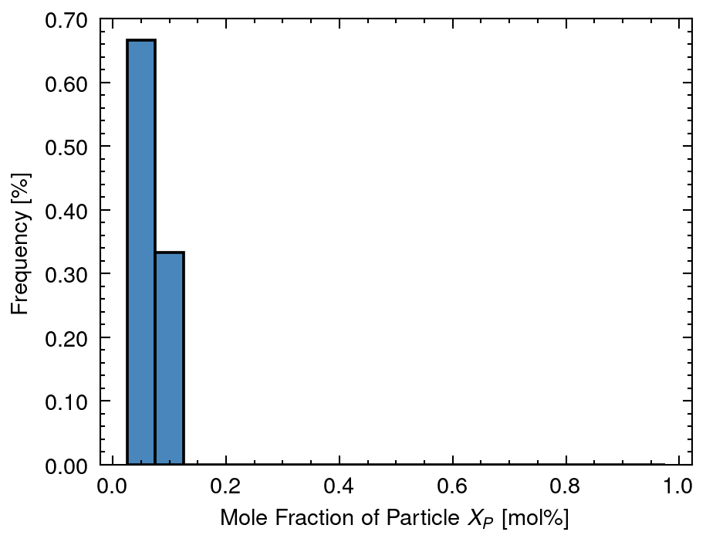
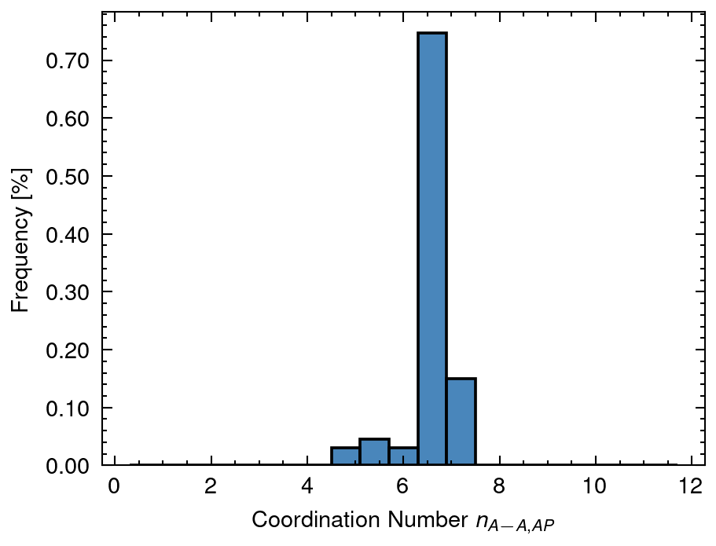
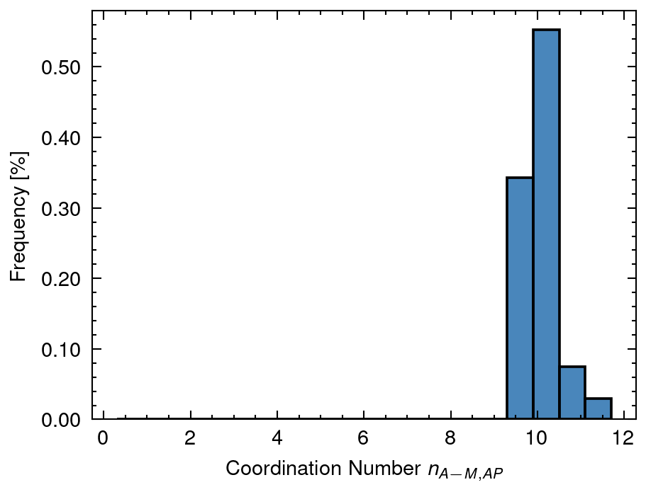
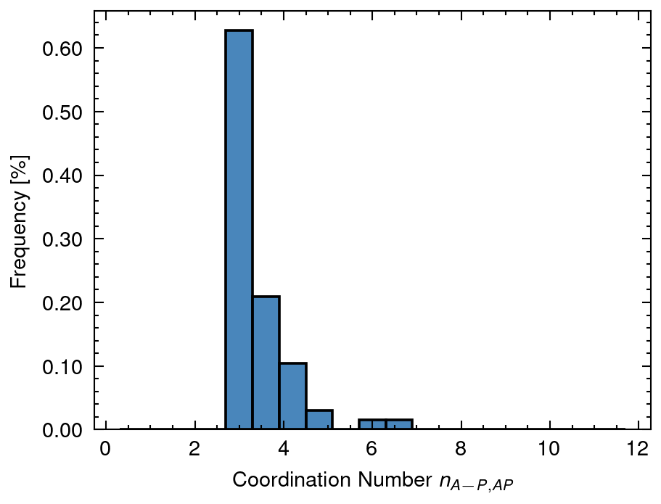
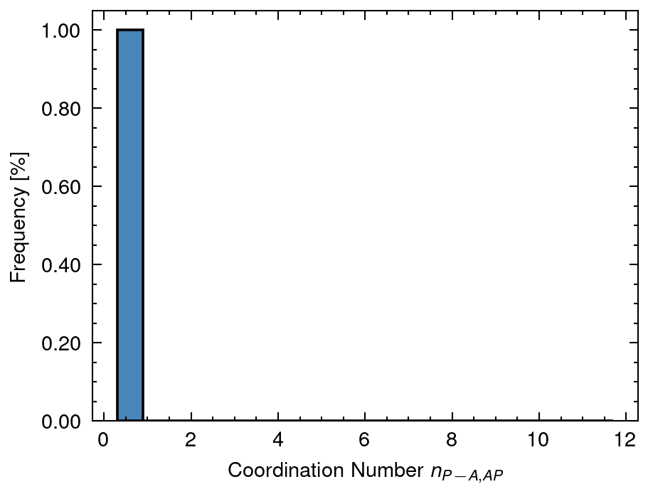
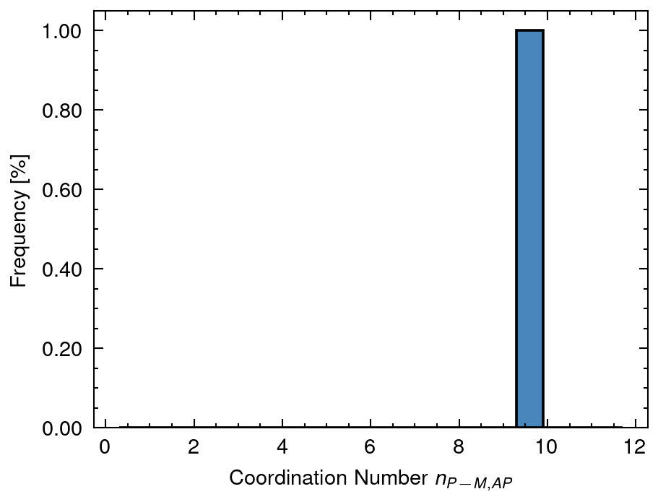
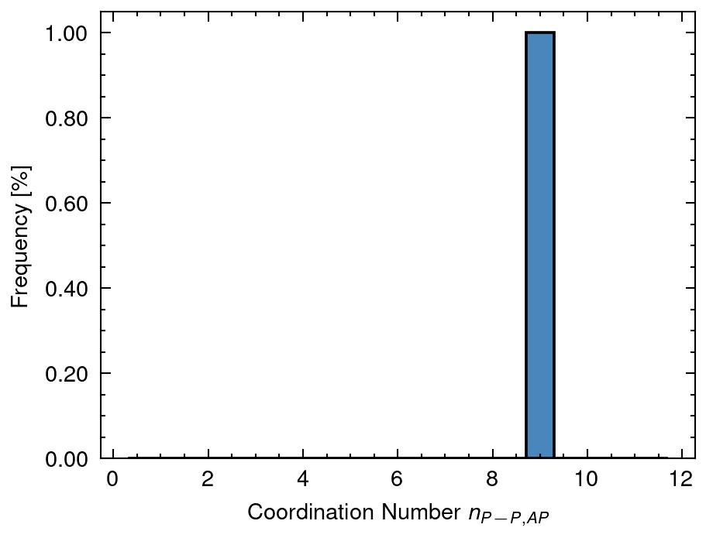
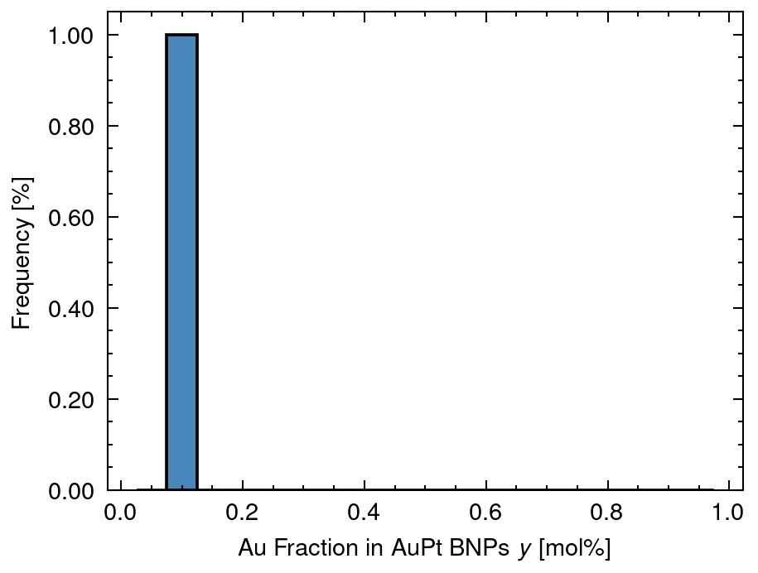
3 Distribution of solved data
XA mean: 0.81 sd:0.1
XAP mean: 0.18 sd:0.1
XP mean: 0.02 sd:0.03
nAA_AP mean: 6.55 sd:0.44
nAM_AP mean: 10.07 sd:0.34
nAP_AP mean: 3.52 sd:0.59
nPA_AP mean: 0.33 sd:0.05
nPM_AP mean: 9.52 sd:0.03
nPP_AP mean: 9.2 sd:0.07
y mean: 0.09 sd:0.0

Slide 10
4 Distribution of n (Overall Cordination Number)
nAA_A mean: 6.59 sd:0.0
nMM_AP mean: 9.57 sd:0.0
nPP_P mean: 7.1 sd:2.9

Slide 11
5 Distribution of X (Fraction of Nanoparticle)
XA mean: 0.81 sd:0.1
XAP mean: 0.18 sd:0.1
XP mean: 0.02 sd:0.03

Slide 12
6 Distribution of y (Fraction of Au in Nanoparticle)
y mean: 0.09 sd:0.0

Slide 13
7 Distribution of D (Atomic Distance)
DA mean: 6.0 sd:0.0
DAP mean: 18.0 sd:0.0
DP mean: 9.79 sd:5.96

Slide 14
8 Distribution of n (Coordination Number of Nanoparticle)
nAA_AP mean: 6.55 sd:0.44
nAM_AP mean: 10.07 sd:0.34
nAP_AP mean: 3.52 sd:0.59
nPA_AP mean: 0.33 sd:0.05
nPM_AP mean: 9.52 sd:0.03
nPP_AP mean: 9.2 sd:0.07

